Slide 1
Data Structures/Big Data 3
Chulalongkorn University
School of Integrated Innovation
Fall 2023
Marko Niinimaki, marko.n@chula.ac.th
Notes:
Google DB

Slide 2
From last week
Storing data in files. What are files like (examples of text and binary files). Let's not forget that programs (executable files) are files, too! Including your computer's operating system.
Sorting: We found out the selection sort is not very good with lots of data. Time complexity O(n²). But there are faster methods, O(n * log n).
Example: 10 000 elements. An O(n²) would need 10 000 x 10 000 operations to sort. An O(n * log n) much less. What is log₂ of 10 000?
Assignment feedback: Most frequent word, CSV files.

Slide 3
From last week
ChatGPT's word frequency counter. Elegant but we don't need to understand all of it.
from collections import Counter
import re
def most_frequent_word(file_path):
with open(file_path, 'r') as file:
content = file.read()
# Remove punctuation and convert to lowercase
cleaned_content = re.sub(r'[^\w\s]', '', content).lower()
words = cleaned_content.split()
word_counts = Counter(words)
most_common_word, most_common_count = word_counts.most_common(1)[0]
return most_common_word, most_common_count
file_path = 'lorem.txt'
most_common_word, most_common_count = most_frequent_word(file_path)
print(f"The most frequent word is '{most_common_word}' with a count of {most_common_count}.")

Slide 4
Today’s main topics
What if we have so much data we cannot fit it in the memory?
What are database management systems:
https://www.youtube.com/watch?v=D-k-h0GuFmE (-> 7 min min, Stanford)
Different flavours of databases:
https://www.youtube.com/watch?v=W2Z7fbCLSTw (10 min)
Databases in the web 1: Basic WWW technologies.
A quick demo of a database (time permitting).

Slide 5
How about searching?
You've started an online game studio and your game is a hit! Millions of people play many rounds every day .. but you want to get the users even more hooked.
You'd like to implement this kind of feature:
Only registered users can get their top scores in the hall of fame. The hall of fame has currently millions of scores in an ascending order. Many of them are "identical" (the same score). NB: Descending order..
For unregistered users who play your game you'd like to show a message like:
"If you had registered your score would be in position 6000! Register!" How?
0 | 1 | .. | 6000 | 6001 | 6002 | .. | 100001 | 100002 | ...
80999 | 80900 |  | 10700 | 10655 | 10655 |  | 2000 | 2000

Slide 6
Some very basic web technologies 1
The web (WWW, World Wide Web) was invented by Tim Berners-Lee at CERN around 1989. It relied on two basic ideas:
The web server is a process in a computer, listening to requests and sending responses. By default it listens to port 80.
The responses are normally web pages that the requester can render (display visually).
The request protocol is called HTTP (HyperText Transfer Protocol). The language in which the web pages are written is called HTML (HyperText Markup Language).

Slide 7
Some very basic web technologies 2
HTML and HTTP are standards managed by the World Wide Web Consortium (W3C where Tim B-L works). W3C manages many other standards, too (XML, RDF etc).
If you type a “name” like “scii.chula.ac.th” in your browser, something like this may happen:
Your operating system’s network component (there: the DNS resolver) translates scii.chula.ac.th into its corresponding IP address.
Your browser sends a “GET /” request to the IP address (but it likes HTTPS).
The server responds by a web page. The browser displays it.

Slide 8
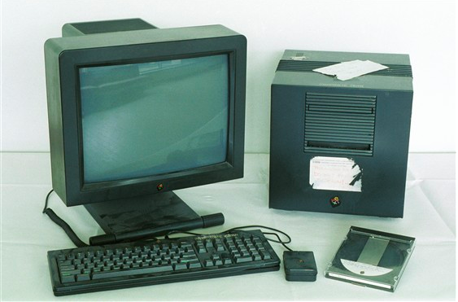

Slide 9
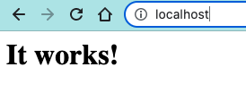
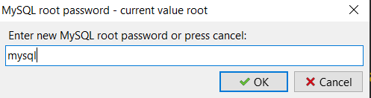
A small demonstration
If you have a Mac (or a Linux PC), you can start a web server by typing
sudo apachectl start
in the terminal window.
Then, in your browser, type
http://localhost (or http://localhost:80).
If you have a Windows PC, please install https://www.uniformserver.com/
Unzip, start UniController.exe and set the database password.

Slide 10
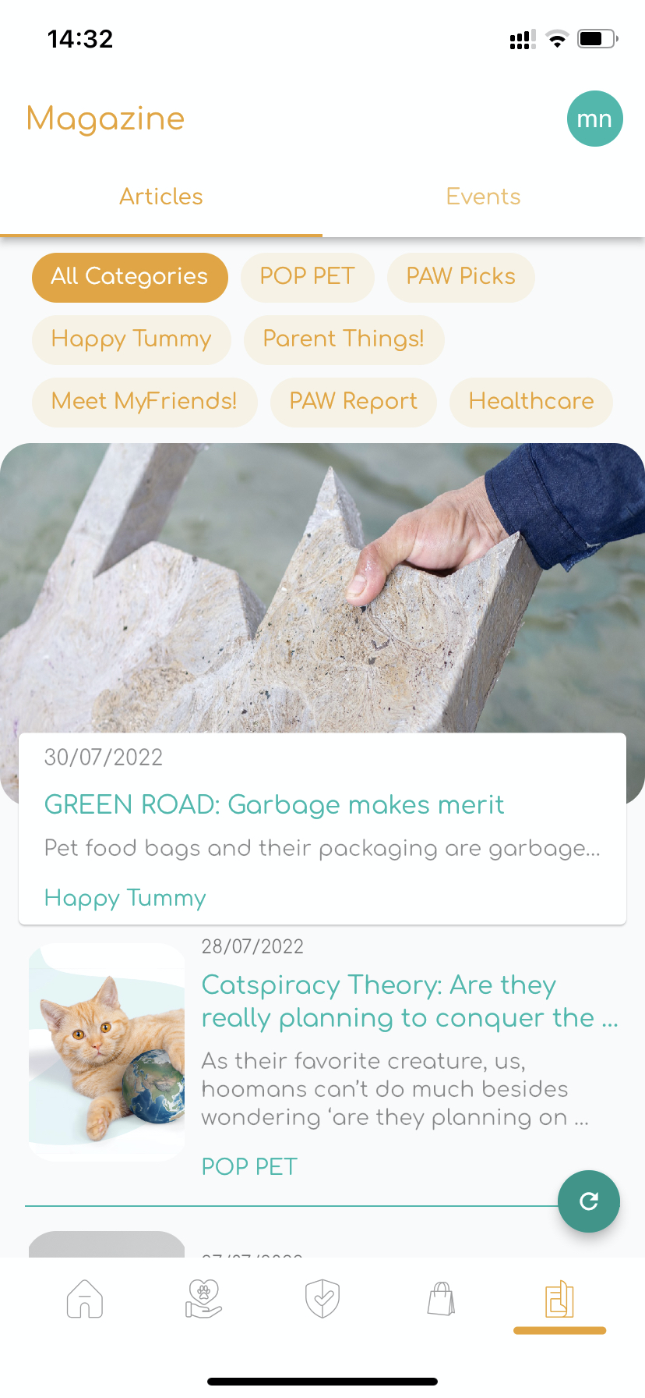
Mobile Applications
Mostly the same principle as WWW, unless your mobile app never communicates outside the device (a calculator app can be like that).
For applications that communicate the application that you see is called the frontend and the server where it gets it data is called the backend. The frontend is practically a web server that responds to requests..
But the responses are very often structured data in the JSON format. The application parses the data and displays parts of it.
A server (backend) at Amazon has all the article data and sends e.g. Healthcare articles if the user selects the Healthcare button in the frontend.

Slide 11
What next..
Our labs this week:
Google + data + web.
How about web + databases? A typical way to build a database enabled web application is called LAMP (or a LAMP stack): https://www.youtube.com/watch?v=N_VmerNUJwI

